Slide 1

Mapping the Open Source Ecosystem
for Climate Science and Sustainable Technology
Richard Littauer, Tobias Augspurger, Alex Stinson, Pierre Vogler-Finck, Andrew Nesbitt, Chris Harris
https://opensustain.tech

Slide 2
Why are we talking here today?
The climate crisis is urgent, deadly, and difficult.
Solutions will involve collaboration and ingenuity.
Open source software offers the best possible chance of enabling a fast, effective response.
We want to facilitate its discovery, maintenance and use.
OpenSustain.tech is the largest, curated, open database of OSS used in climate science.

Slide 3
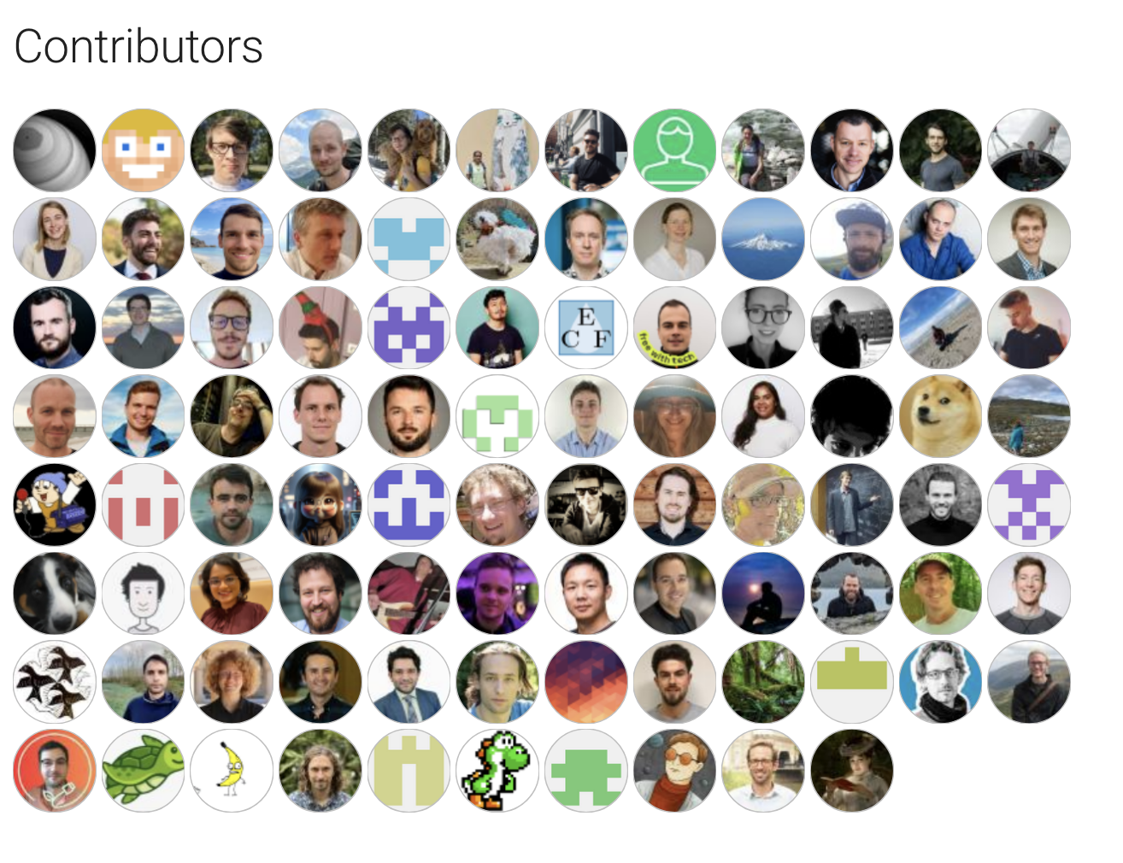
Who are we?
Who are we?
Richard Littauer
CURIOSS, SustainOSS, PythonNZ
Alex Stinson (with apologies):
Wikimedia Foundation, Work on Climate, Climate Drift

Slide 4
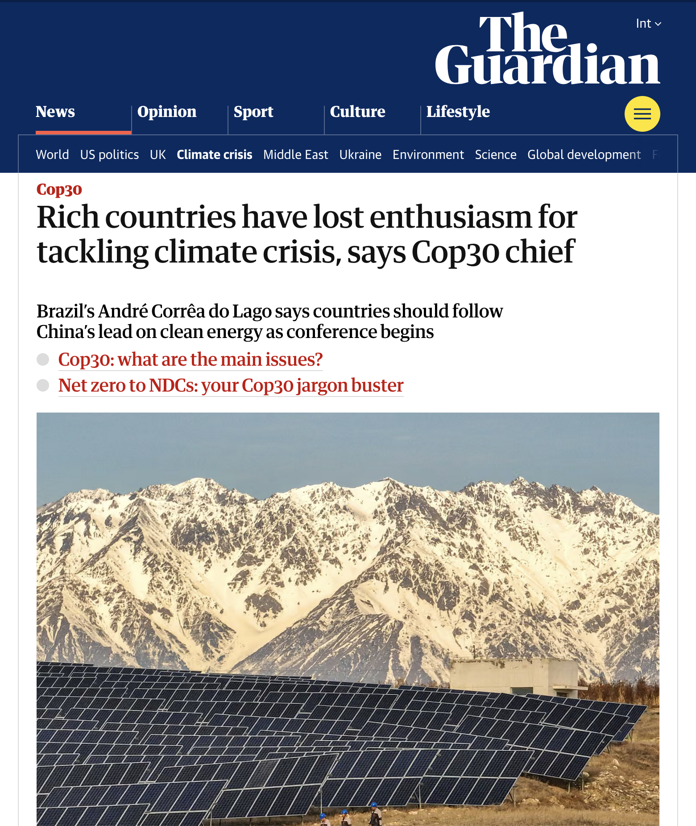
The problem
Climate crisis is here.
Solving it will require work from all parts of society.
Governance alone is unlikely to resolve the crisis.

Slide 5
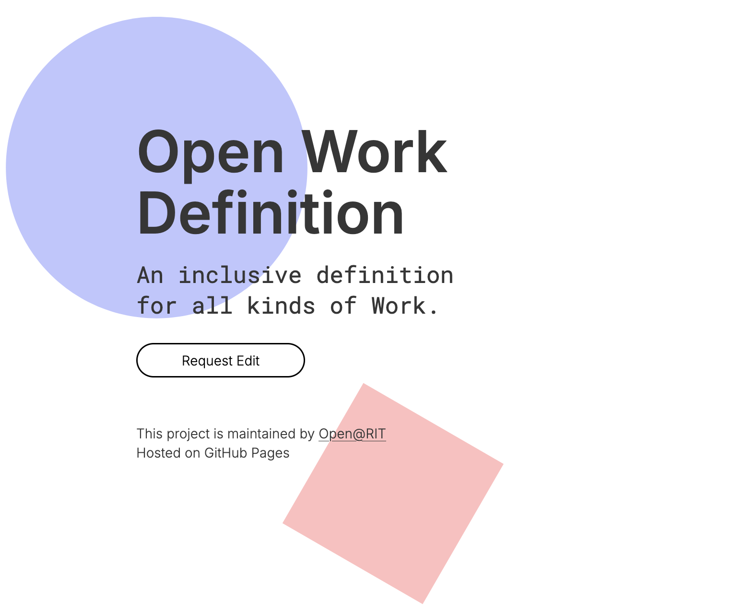
Open work can help
Open * can help
Open organizing, science, data, models, access, knowledge, source.
Top-down approach: funders, governmental policies.
Bottom up: individual researchers, individual projects.

Slide 6
OSS
Who are we?
OSS
1/3rd of all of repositories on GitHub
70-90% of software has open source in it (LF, 2022); 97% (Black Duck, 2025)
Supply side worth is $4 billion; demand $9 trillion (Nagle et al.).

Slide 7
OSS in Climate
OSS
Who are we?
OSS in climate science
No clear, predictable links
Big Tech is disincentivized to release open models
Government accountability is unreliable globally
DPGs may provide some help in the future.

Slide 8
Open Sustain Technology
OSS in Climate
OSS
Who are we?
Open Sustain Technology
https://opensustain.tech
OSS-community driven project
Started by Tobias Augspurger in 2020
Diverse team - academics, climate scientists, OSS ecosystem workers.
Collaborations with Linux Foundation, GitHub, and others.

Slide 9
Open Sustain Technology
OSS in Climate
OSS
Who are we?
Finding projects themselves is hard
No clear internet-wide search engines for OSS
Online marketing and AI slop causes semantic bleaching
Polysemic terms: "cloud", "climate", "environment"
Flood of low-quality OSS projects
GitHub stars overinflate usage metrics
No standardized citation format for used papers
No standardized protocols for policy usage

Slide 10
List-based approach
Prioritizes human curation
Enables collaboration and re-use under open licensing
Enables loose definitions of inclusion
Uses existing systems (PRs, Markdown) in tech
Open Sustainable Technology's mission is to find, list, and share projects that preserve or analyze natural ecosystems through open technology, methods, data, intelligence, knowledge or tools.

Slide 11
Criteria
OSS license?
Demonstrable usage and goals that are relevant to environmental sustainability?
Active usage or development in the last year?
Use outside the project (citations, opened issues, citations or downloads)?
Documentation for re-use?

Slide 12
Sections
Sections
Human systems:
Renewable Energy
Energy Storage
Energy Systems
Consumption
Emissions
Industrial Ecology
Sustainable Development
Natural resources:
Biosphere
Cryosphere
Hydrosphere
Atmosphere
Climate Change
Natural Resources

Slide 13
Basic Stats
Sections
Basic statistics
2,497 total projects
2,372 on GitHub
70% active in the last year
OST: 106 contributors, 84% by Tobias, 10~ other regular contributors

Slide 14
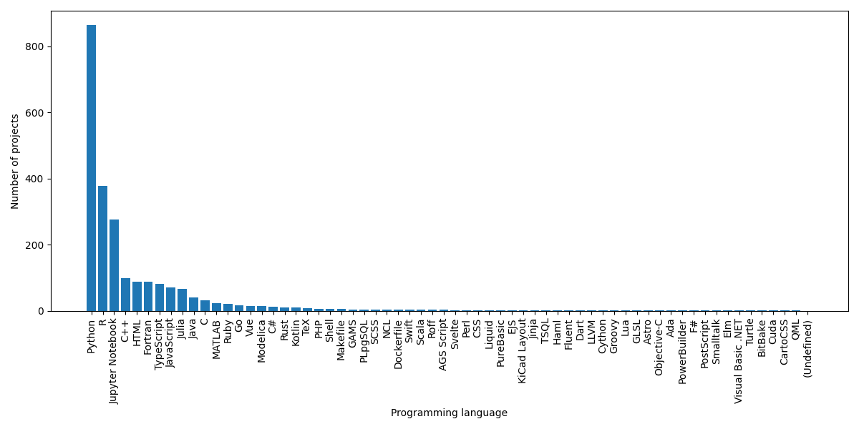
Basic Stats
Sections
Programming languages

Slide 15
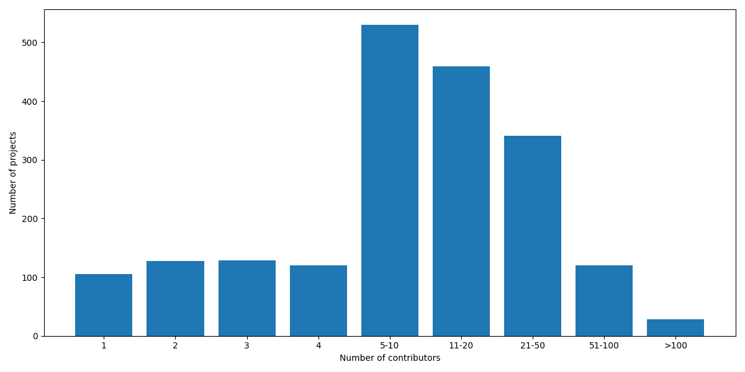
Basic Stats
Sections
Number of contributors

Slide 16
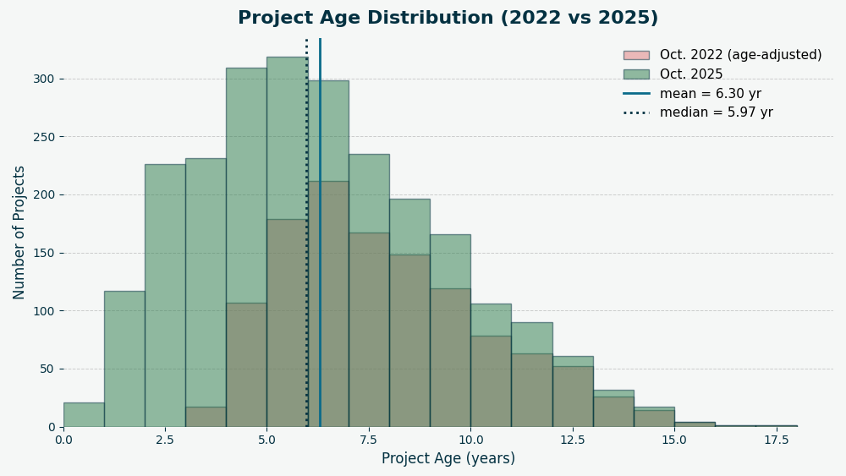
Age Distribution
Basic Stats
Sections
Age distribution

Slide 17
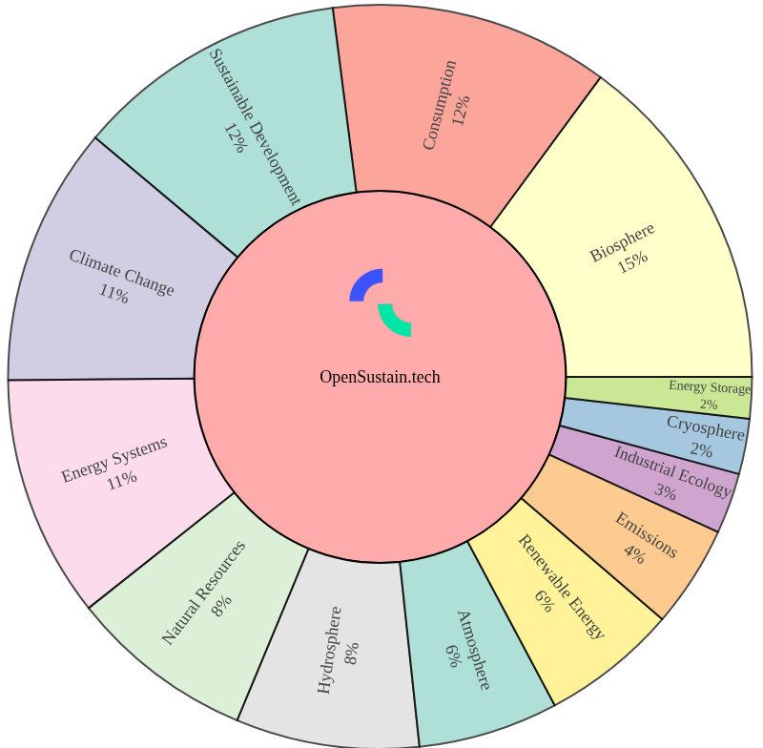
Categories
Categories

Slide 18
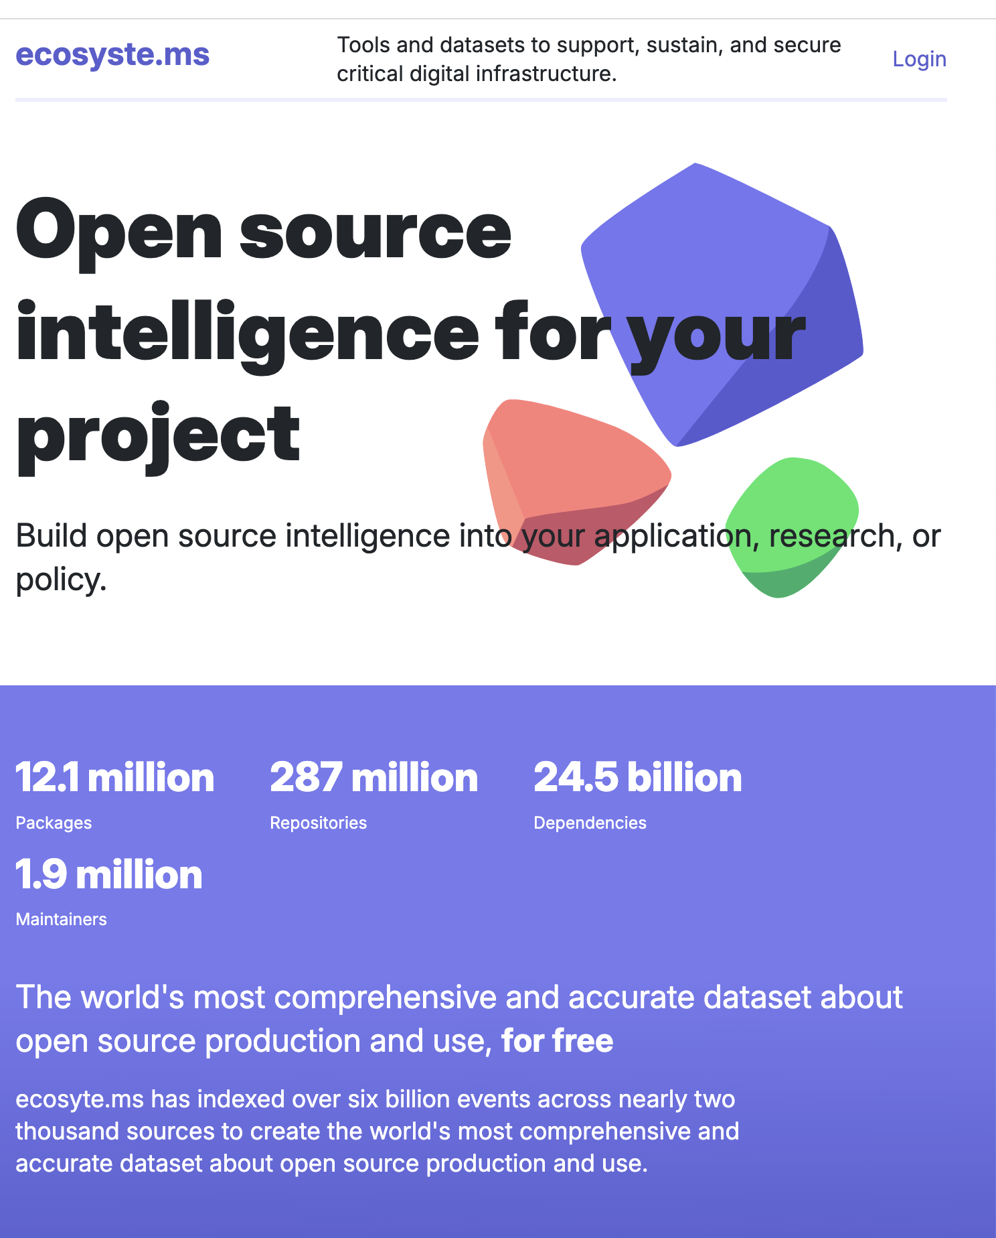
Dependencies
Basic Stats
Sections
Dependencies
27,482 projects use OST-listed projects as deps
7,776 unique repositories; 2,715 unique packages
370 projects depend on other OST packages
52,559 dependencies; 14,518 unique packages

Slide 19
Ecosyste.ms Science Score
Dependencies
Basic Stats
Sections
Ecosyste.ms Science Score
Average score is 43.07 (median 39).
1,829 (72.1%) of the projects had a Zenodo.json file
1,335 (52.6%) had academic emails in their commit messages;
959 (37.8%) had DOI references
859 (33.9%) had academic publication links.
343 (13.5%) had Citation.cff files
230 (9.1%) of the projects had an institutional organizational owner
172 (6.8%) of the projects were linked to JOSS papers.

Slide 20
Summary
Summary
OSS is definitely in use across the climate science ecosystem.
The economic argument for OSS needs to be fleshed out.
Better standards for citing and linking packages are necessary.
And we need more resourcing for OpenSustain.tech itself.

Slide 21
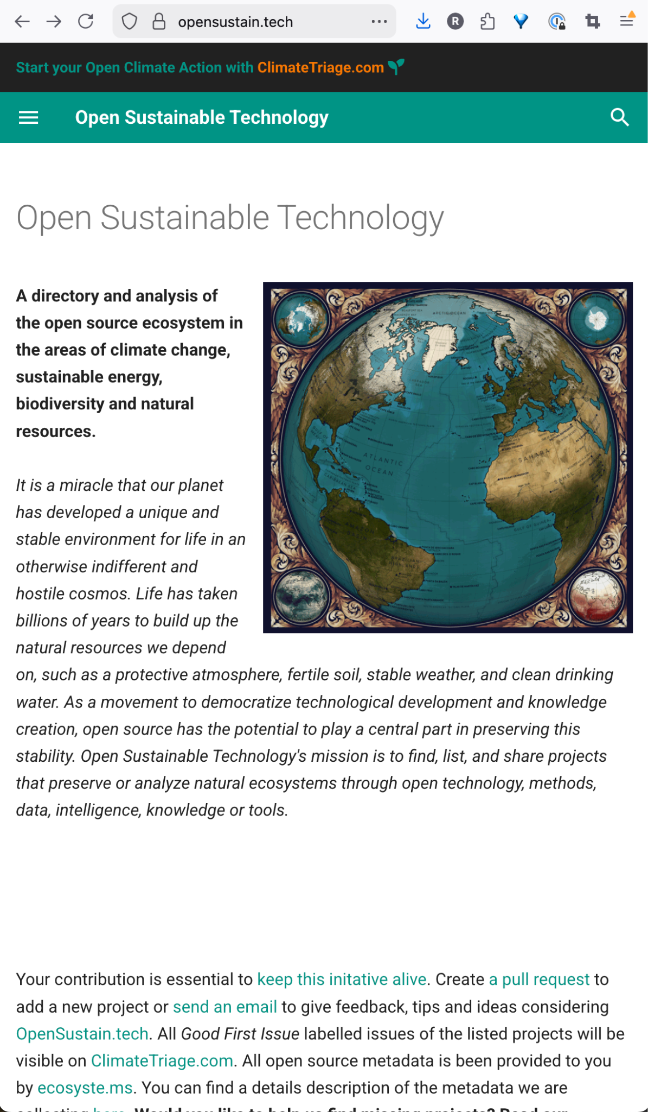
Thanks
Join us at https://opensustain.tech.

